Slide 1
WETA Parent Engagement Webinar Series
Home and Family Literacy
Thursday, September 27, 2012

Slide 2
Who We Are
TRC’s Mission: To improve the lives of at-risk children and families by helping them create and sustain literacy-rich environments and motivation for reading.
TRC’s Vision: That every TRC kid becomes a regular and passionate reader.

Slide 3
What We Have Done
Twenty-four years ago, three Arlington teachers started reading aloud with some of their students at a nearby, newly opened homeless shelter. That was the beginning of the Read-Aloud program, where volunteers read aloud each week with at-risk kids.
Today, four programs offer a continuum of service for at-risk families. They are
The Read-Aloud Program
The Book Club
Reading Families Workshops
Literacy Advocates Trainings
“The single most important activity for building the knowledge required for eventual success in reading is reading aloud to children.” Becoming a Nation of Readers, 1985

Slide 4
Polling Question
Where do you provide services for your kids?
At school, during the school day
At school during after-school programming
At another site like a recreation center
In their homes
Other

Slide 5
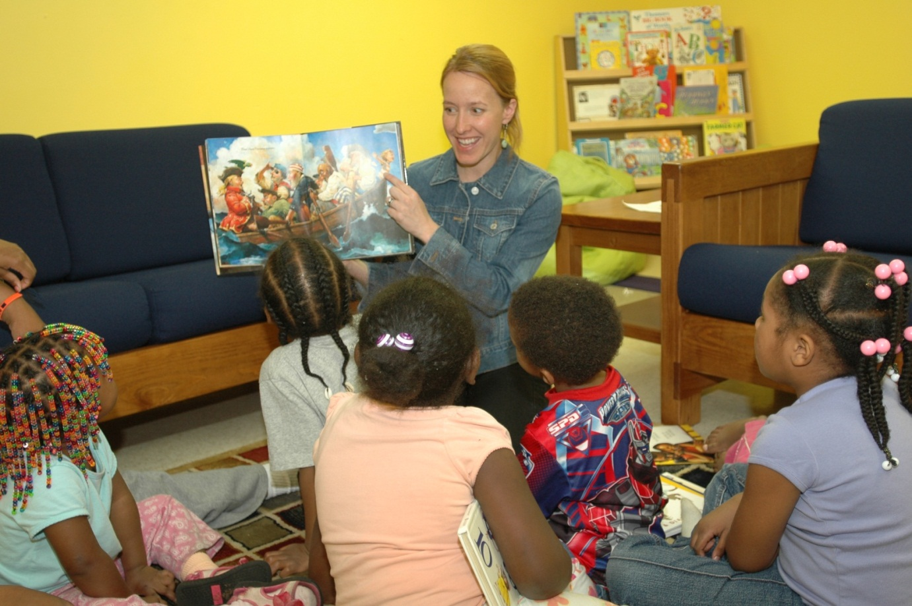
Read-Aloud Program
Volunteers read aloud, do book-related activities and provide free, new books to keep for kids where they live.

Slide 6
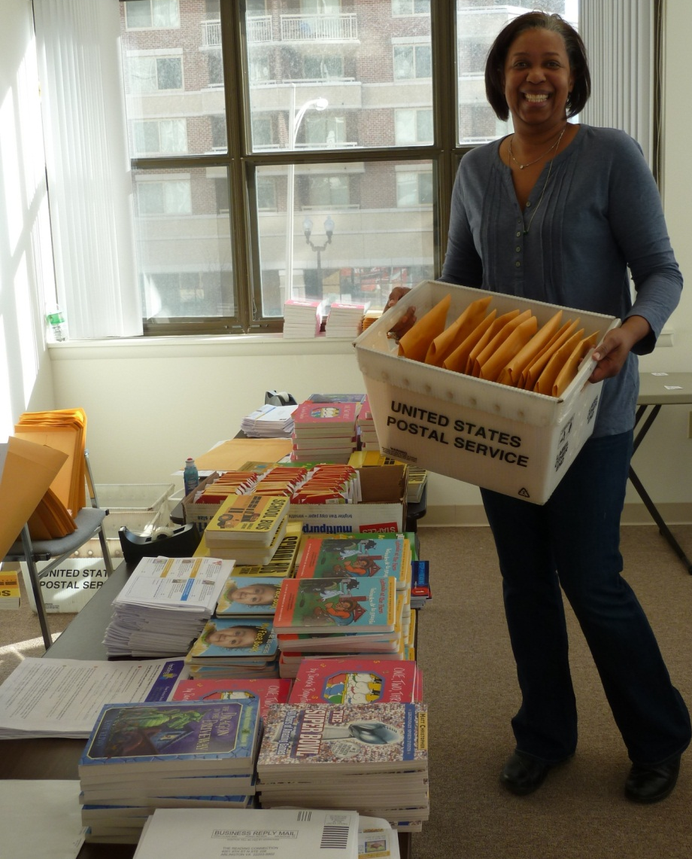
Book Club
TRC's Book Club encourages families to read by sending new, age-appropriate books through the mail to their homes. Participating families are clients of partner social service agencies.

Slide 7
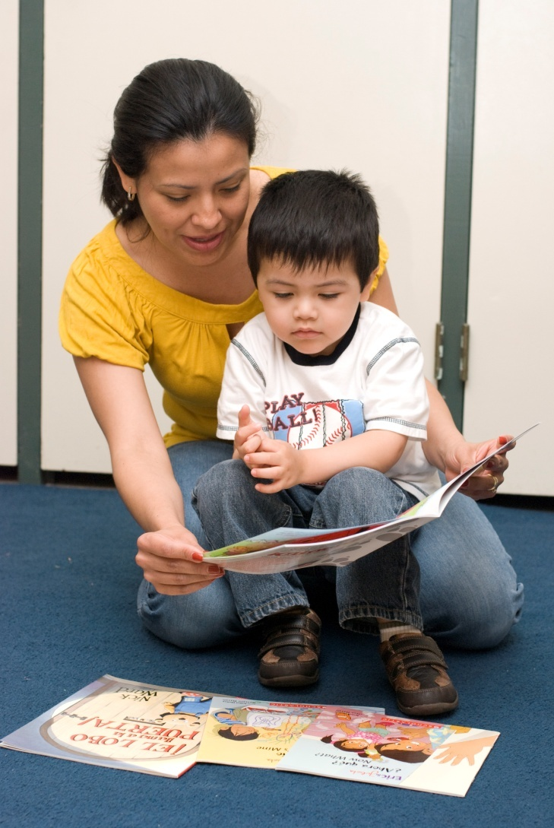
Reading Family Workshops
TRC staff and volunteers work with parents at playgroups and parent-only sessions where they help parents learn how to encourage reading and support literacy development in their own homes.

Slide 8
Literacy Advocates Trainings
TRC staff train partner agency staff about the importance of reading aloud and elements of literacy development.
Agency staff learn how to model book-sharing strategies, build parents’ confidence and answer frequently asked questions.

Slide 9
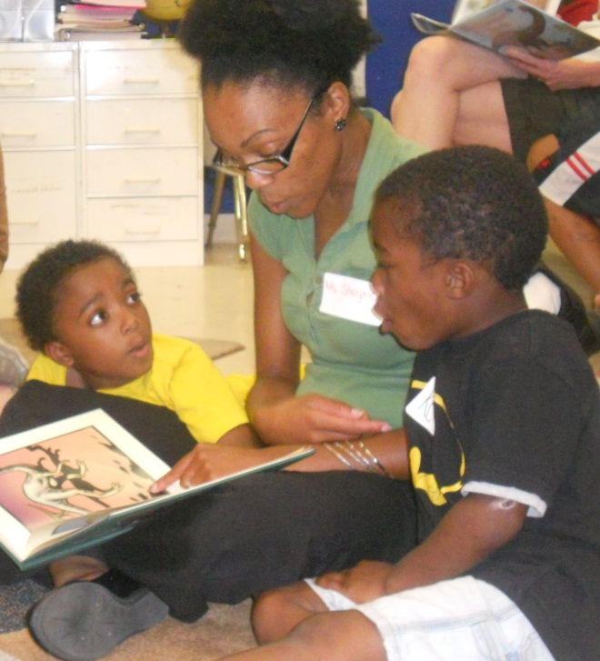
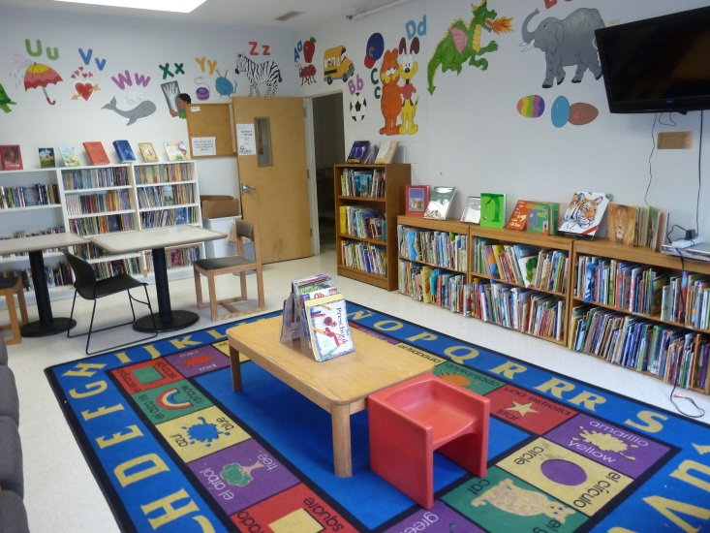
Research basis for TRC’s program
In developing its programs, TRC started from a best- case scenario. We asked, “What are the factors that contribute to creating regular and passionate readers?”

Slide 10
Kids who are the strongest readers…
Have been read aloud to
Have access to books at home and can choose which books they want to read and keep
Have adults who will read and talk with them about what they are reading and act as reading role models
Are motivated and encouraged to read for fun
Have many opportunities to build comprehension skills and background knowledge

Slide 11
Why real-world experiences matter
Real-world experiences build vocabulary and background knowledge. These two factors influence reading comprehension.
Background Knowledge
Dr. Joan Kindig, University of Virginia, TRC Volunteer Training, April 2009
Word Knowledge
 | Strong | Weak
Adequate | High | Low
Inadequate | Moderate | Nil
Probability of comprehension

Slide 12
Polling Question
Which factors affect your kids?
Are they being read aloud to?
Do they have access to books at home?
Do they have adult reading role models?
Are they motivated or encouraged to read?
Do they have opportunities to build vocabulary and background knowledge, especially during the summer?

Slide 13
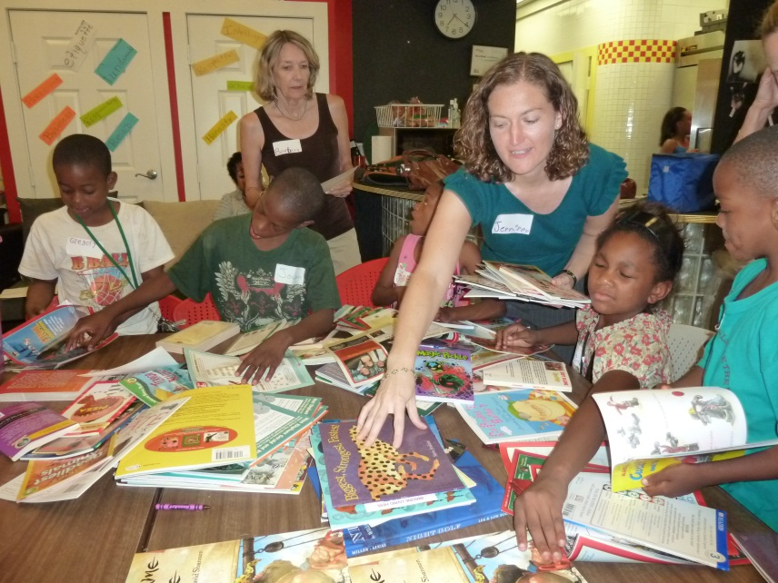
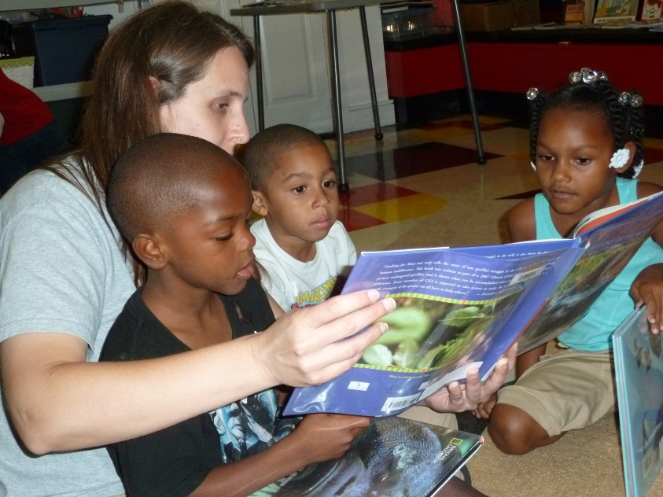
How do we fill the gaps?
Provide access to books kids want to read and adults to read and talk with them

Slide 14
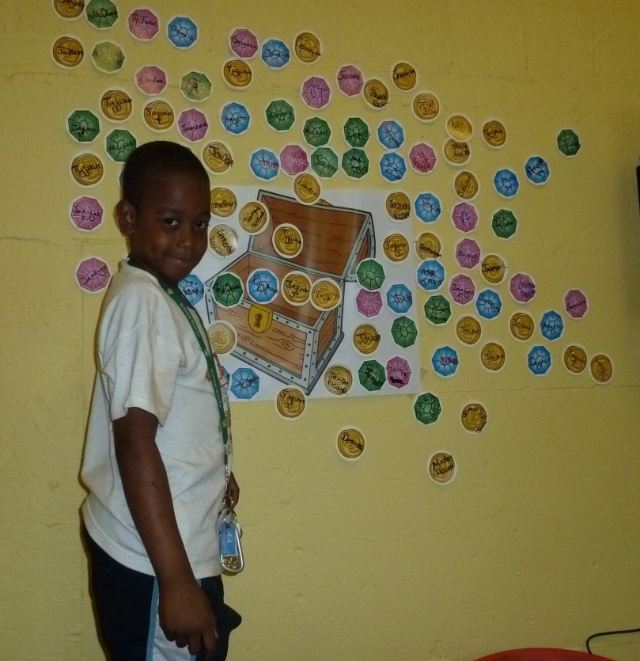
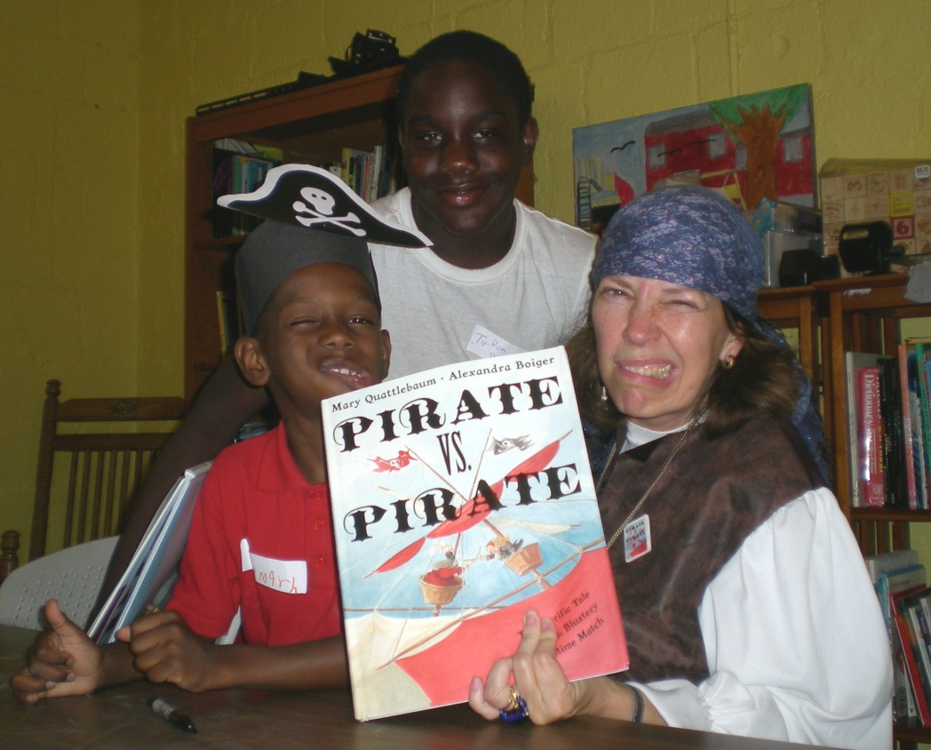
How do we fill the gaps?
Provide opportunities, motivation and rewards for reading for fun

Slide 15
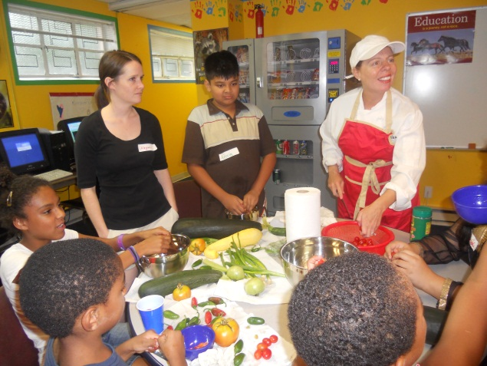
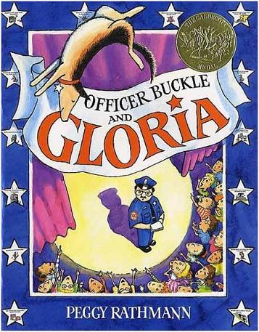
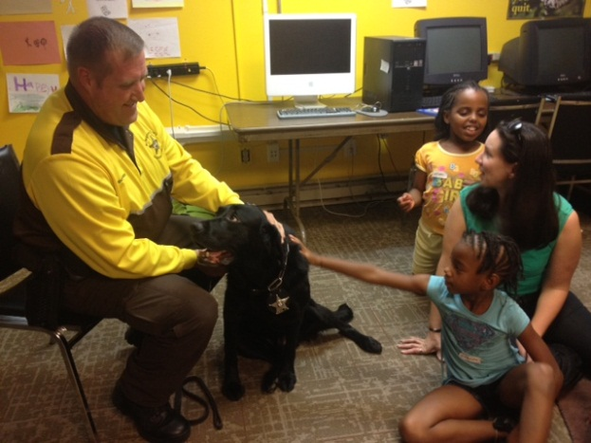
How do we fill the gaps?
Provide a wide variety of real-world, hands-on experiences for the kids and link them to high quality children’s books

Slide 16
What we don’t do:
We do not conduct an adult literacy program or a tutoring program.
We do not ask kids to read-aloud.
We do not provide direct service to families. We work through partner agencies.
We do not use paid staff for most of our program implementation. We use volunteers.
We do not use used books for book ownership. We buy new books for the kids to choose.

Slide 17
Sources for free or low-cost books to give away
Many publishers make discounted books available to nonprofit agencies who give books away to kids.
In Search of Free Books article on the Reading Rockets website
http://www.readingrockets.org/article/57
FirstBook: Their marketplace allows you to purchase multiple copies of specific titles and you pay only for the cost of shipping. You must purchase in quantities they specify. They also have grants allowing you to purchase specific books in quantities you want. Their book bank distributes books to program serving low-income families. http://www.firstbook.org
Scholastic Literacy Partners: You choose from their catalog at a discount of at least 40% off of retail. All paperback or board books. Some Spanish titles available. Free shipping and bonus books for every $150 spent. http://teacher.scholastic.com/products/literacypartners/about.asp
All About Books: Same idea as Scholastic Literacy partners. Free shipping and bonus books for every $100 spent. Good selection of Spanish and bilingual titles. www.allaboutbooks.org
Other publishers—Starbright offers great board books in many languages and Barefoot Books offers picture and board books in English and Spanish. http://www.starbrightbooks.org/about_us.php
http://www.barefoot-books.com

Slide 18
Resources
Richard C. Anderson, Elfrieda H. Hiebert, Judith A. Scott, Ian A.G. Wilkinson, Becoming a Nation of Readers: The Report of the Commission on Reading, Champaign-Urbana, IL: Center for the Study of Reading, 1985.
Patrick J. Finn, Literacy with Attitude: Educating Working Class Children in Their Own Self-Interest, State University of New York Press, 1999.
Mem Fox, Reading Magic: Why Reading Aloud to Our Children Will Change Their Lives Forever, Updated and Revised Edition, Harcourt, 2008.
Linda Gambrell, Closing the Summer Reading Gap, Reading Today, April 2008
National Summer Learning Association, Summer Can Set Kids on the Right—or Wrong—Course, http://www.summerlearning.org/resource/collection/CB94AEC5-9C97-496F-B230-1BECDFC2DF8B/Research_Brief_02_-_Alexander.pdf
Jim Trelease, The Read-Aloud Handbook Sixth Edition, Penguin, 2006.

Slide 19
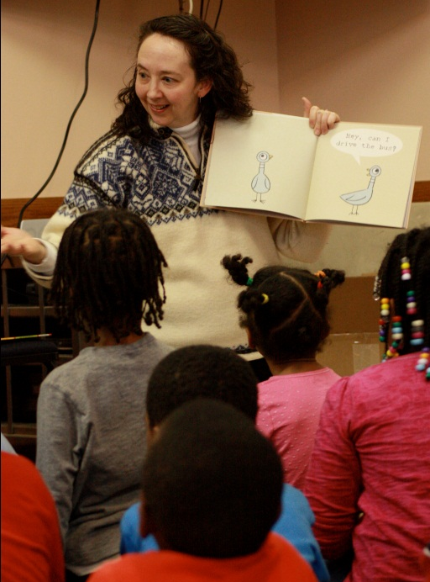
Questions? Contact me!
Eileen Hanning
Education Specialist
ehanning@thereadingconnection.org
703.528.8317 ext. 11
Also check out our website and our blog:
www.thereadingconnection.org
http://trctraininghub.blogspot.com

