Slide 1





The flagship public television and radio station in the nation's capital
WETA Learning Media
Notes:
So I’d like to talk today about how we’re using public broadcasting and the Web to serve a mission that we share with everyone in this room: to provide the best, most compelling information about giving every child the best possible opportunity to become a skilled and passionate reader and writer.
RR based at PBS—consciously created a new model—stay with a field for a long time, get to know partners, etc. Build an audience based on the web, with TV as a billboard for the project.
I’ll spend a few minutes letting you know what we do, and then talk about something equally important: how we have built our audience.

Slide 2
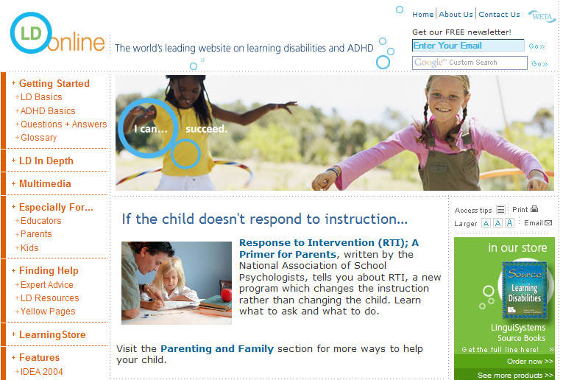



WETA Learning Media
Our Education Projects
Notes:
Since starting the department about 10 years ago, we have created, in effect, four new channels: Reading Rockets, LD OnLine, Colorin Colorado, and, most recently, AdLit.org.
Starting from scratch, we’re producing programs for PBS. We’re building national brands on the Web that now serve more than 500,000 unique visitors each month. We publish electronic newsletters that reach more than 170,000 subscribers. And most important, we’ve managed to take some complex subjects and present them in a way that’s accessible to the average teacher, the average principal, the average parent. We’ve created, I think, a powerful model of public education on a national scale.

Slide 3
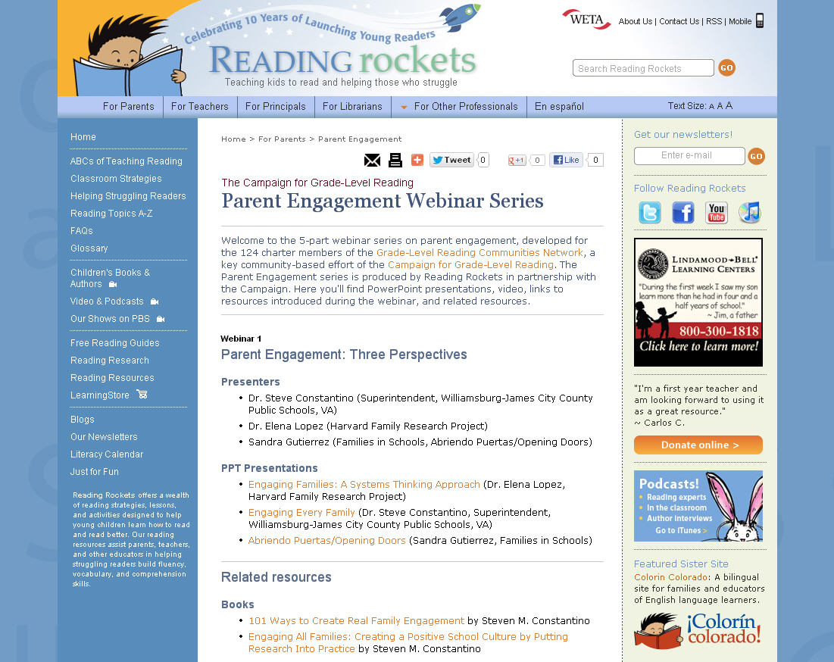

Slide 4
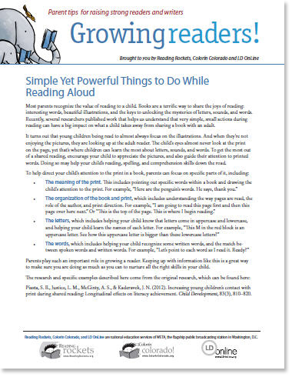
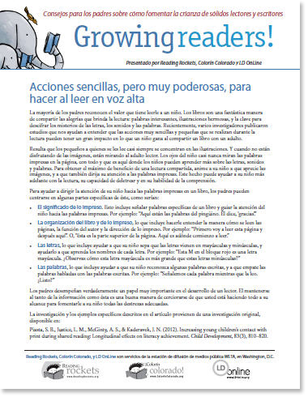
WETA Learning Media
Reading Rockets Parent Newsletter

Slide 5
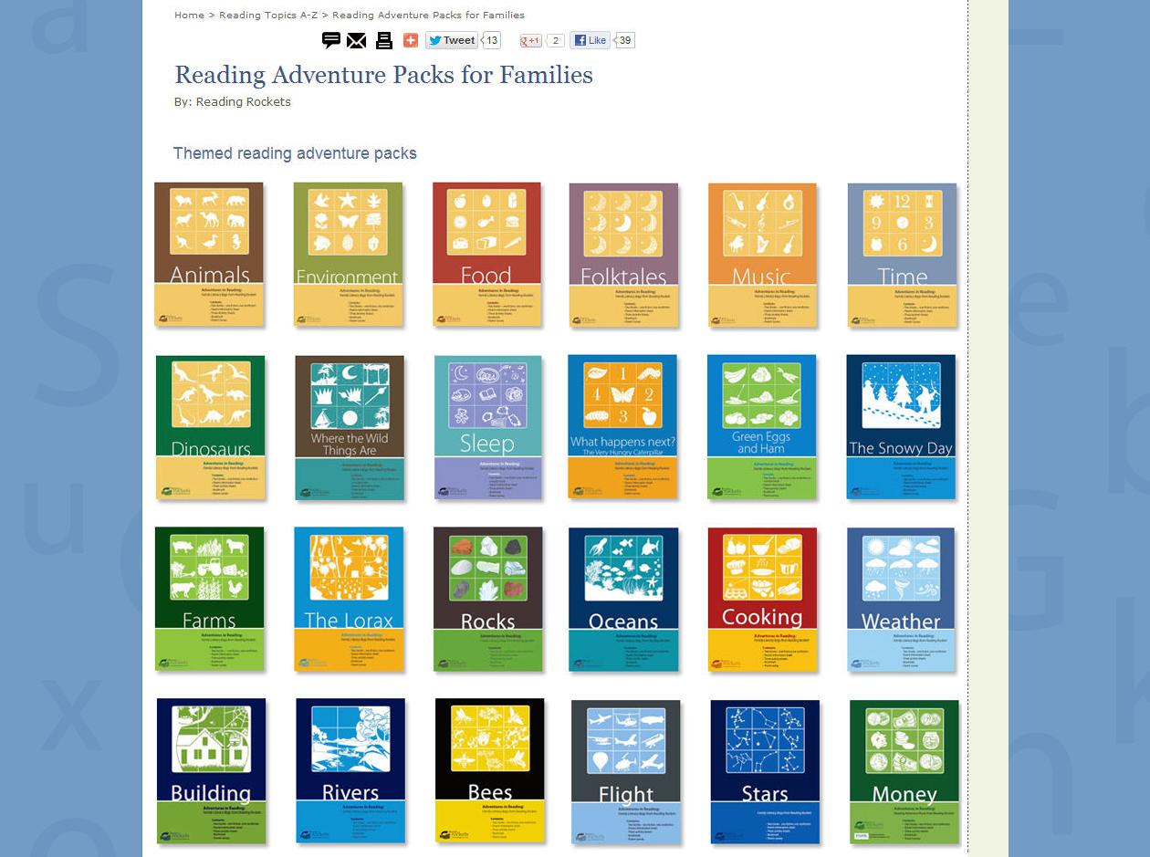
Notes:
The core of our work, though, is on the Web. The Web gives a chance to provide in-depth information, to serve people 24 hours a day, and to interact with the parents and educators who rely on us.
Our Web site is updated daily and constantly revised and improved. If you visit Reading Rockets, here’s some of what you’d see.
Today’s Headlines presents daily articles from newspapers around the country about reading and elementary education
There’s a vast archive of articles about every element of teaching reading.
Ask Reading Rockets offers expert, personalized answers to questions that a parent or teacher may have about teaching reading.
There’s a section with new content such as a feature about summer reading or some tip sheets we’ve created for parents
There’s a place to sign up for our free electronic newsletter
And there’s information about our TV shows and when they’re scheduled to be broadcast in your community
We also offer special sections for principals, school psychologists and other professionals, interviews with prominent children’s book authors, and two blogs about reading and books

Slide 6

Notes:
The core of our work, though, is on the Web. The Web gives a chance to provide in-depth information, to serve people 24 hours a day, and to interact with the parents and educators who rely on us.
Our Web site is updated daily and constantly revised and improved. If you visit Reading Rockets, here’s some of what you’d see.
Today’s Headlines presents daily articles from newspapers around the country about reading and elementary education
There’s a vast archive of articles about every element of teaching reading.
Ask Reading Rockets offers expert, personalized answers to questions that a parent or teacher may have about teaching reading.
There’s a section with new content such as a feature about summer reading or some tip sheets we’ve created for parents
There’s a place to sign up for our free electronic newsletter
And there’s information about our TV shows and when they’re scheduled to be broadcast in your community
We also offer special sections for principals, school psychologists and other professionals, interviews with prominent children’s book authors, and two blogs about reading and books

Slide 7
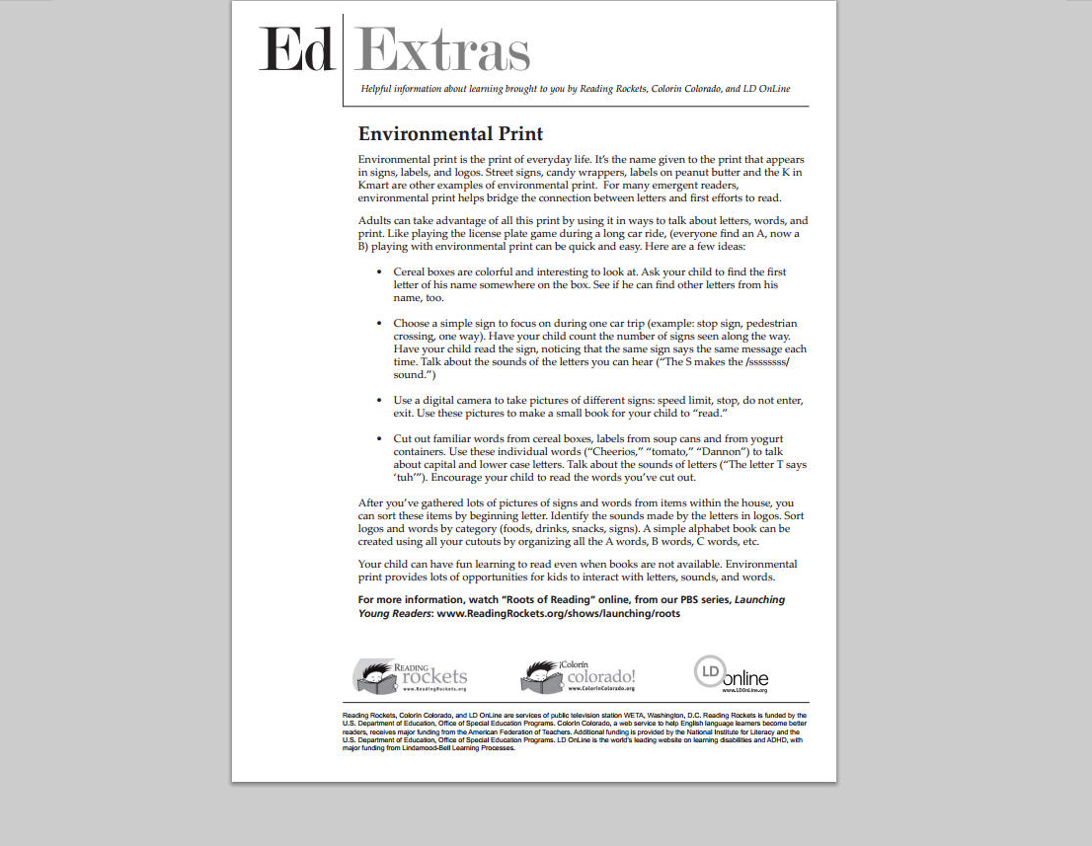
Notes:
The core of our work, though, is on the Web. The Web gives a chance to provide in-depth information, to serve people 24 hours a day, and to interact with the parents and educators who rely on us.
Our Web site is updated daily and constantly revised and improved. If you visit Reading Rockets, here’s some of what you’d see.
Today’s Headlines presents daily articles from newspapers around the country about reading and elementary education
There’s a vast archive of articles about every element of teaching reading.
Ask Reading Rockets offers expert, personalized answers to questions that a parent or teacher may have about teaching reading.
There’s a section with new content such as a feature about summer reading or some tip sheets we’ve created for parents
There’s a place to sign up for our free electronic newsletter
And there’s information about our TV shows and when they’re scheduled to be broadcast in your community
We also offer special sections for principals, school psychologists and other professionals, interviews with prominent children’s book authors, and two blogs about reading and books

Slide 8
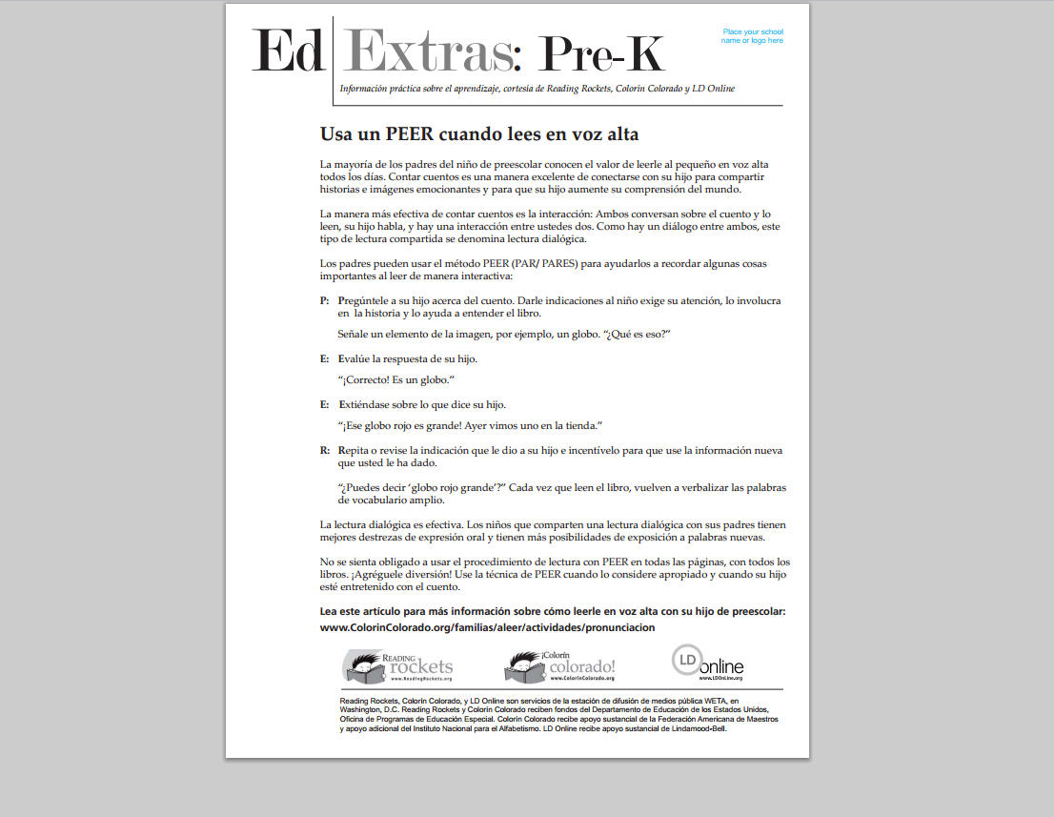
Notes:
The core of our work, though, is on the Web. The Web gives a chance to provide in-depth information, to serve people 24 hours a day, and to interact with the parents and educators who rely on us.
Our Web site is updated daily and constantly revised and improved. If you visit Reading Rockets, here’s some of what you’d see.
Today’s Headlines presents daily articles from newspapers around the country about reading and elementary education
There’s a vast archive of articles about every element of teaching reading.
Ask Reading Rockets offers expert, personalized answers to questions that a parent or teacher may have about teaching reading.
There’s a section with new content such as a feature about summer reading or some tip sheets we’ve created for parents
There’s a place to sign up for our free electronic newsletter
And there’s information about our TV shows and when they’re scheduled to be broadcast in your community
We also offer special sections for principals, school psychologists and other professionals, interviews with prominent children’s book authors, and two blogs about reading and books

Slide 9
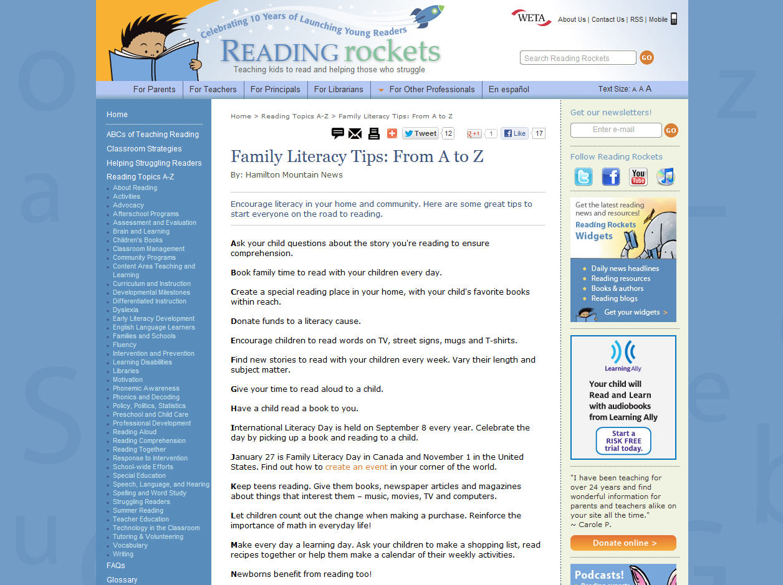
Notes:
The core of our work, though, is on the Web. The Web gives a chance to provide in-depth information, to serve people 24 hours a day, and to interact with the parents and educators who rely on us.
Our Web site is updated daily and constantly revised and improved. If you visit Reading Rockets, here’s some of what you’d see.
Today’s Headlines presents daily articles from newspapers around the country about reading and elementary education
There’s a vast archive of articles about every element of teaching reading.
Ask Reading Rockets offers expert, personalized answers to questions that a parent or teacher may have about teaching reading.
There’s a section with new content such as a feature about summer reading or some tip sheets we’ve created for parents
There’s a place to sign up for our free electronic newsletter
And there’s information about our TV shows and when they’re scheduled to be broadcast in your community
We also offer special sections for principals, school psychologists and other professionals, interviews with prominent children’s book authors, and two blogs about reading and books

Slide 10
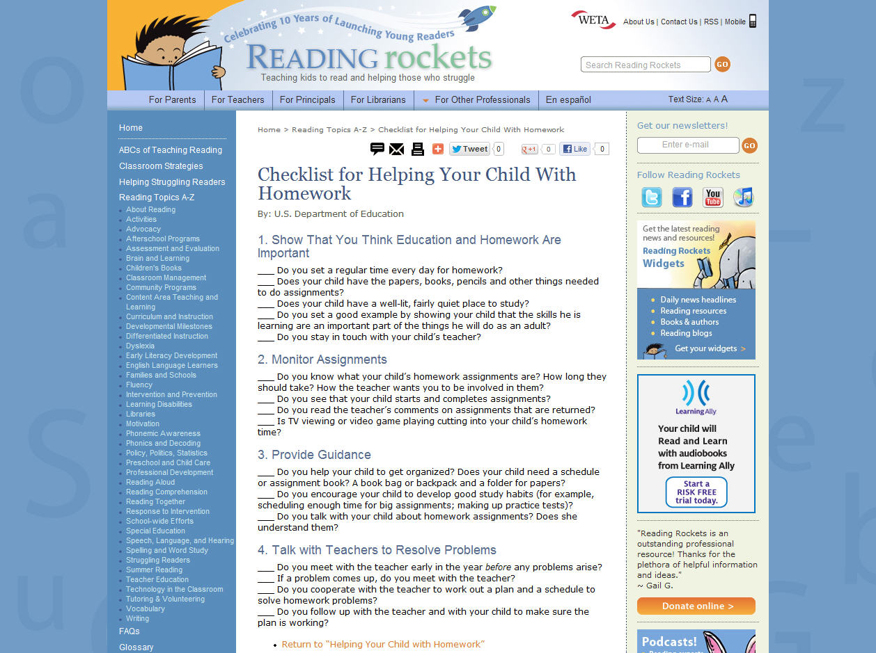
Notes:
The core of our work, though, is on the Web. The Web gives a chance to provide in-depth information, to serve people 24 hours a day, and to interact with the parents and educators who rely on us.
Our Web site is updated daily and constantly revised and improved. If you visit Reading Rockets, here’s some of what you’d see.
Today’s Headlines presents daily articles from newspapers around the country about reading and elementary education
There’s a vast archive of articles about every element of teaching reading.
Ask Reading Rockets offers expert, personalized answers to questions that a parent or teacher may have about teaching reading.
There’s a section with new content such as a feature about summer reading or some tip sheets we’ve created for parents
There’s a place to sign up for our free electronic newsletter
And there’s information about our TV shows and when they’re scheduled to be broadcast in your community
We also offer special sections for principals, school psychologists and other professionals, interviews with prominent children’s book authors, and two blogs about reading and books

Slide 11
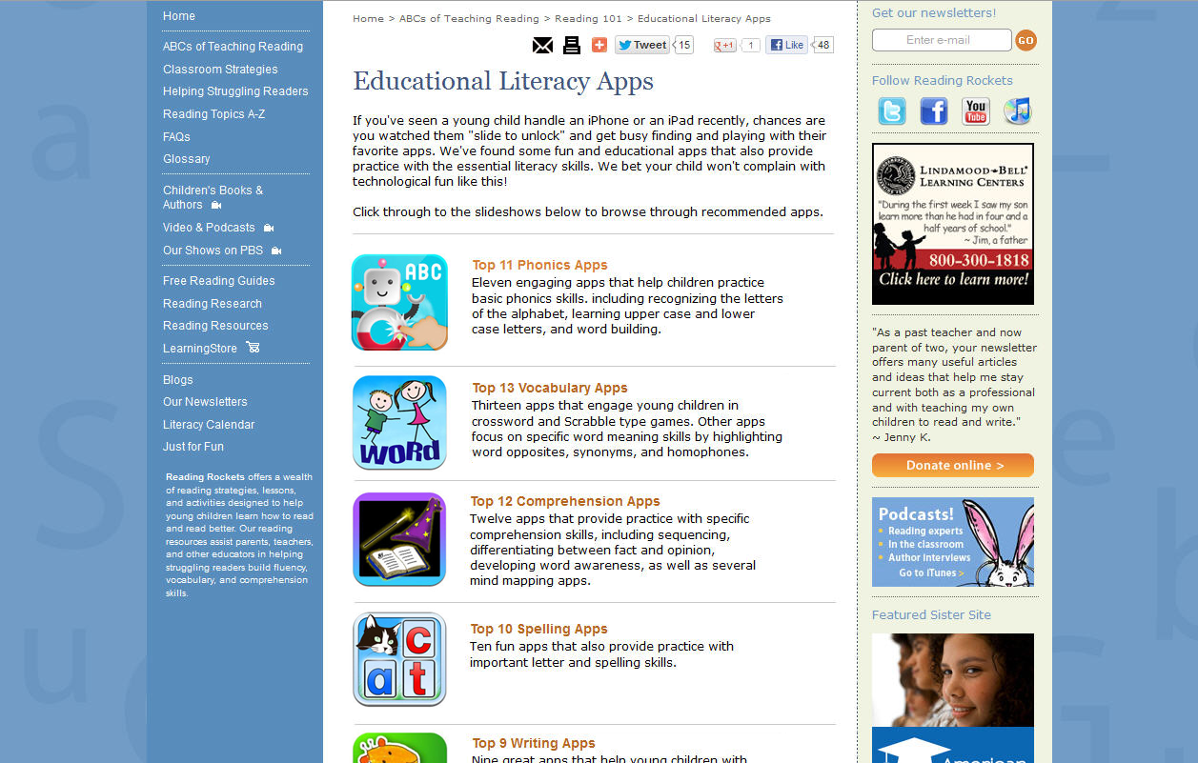
Notes:
The core of our work, though, is on the Web. The Web gives a chance to provide in-depth information, to serve people 24 hours a day, and to interact with the parents and educators who rely on us.
Our Web site is updated daily and constantly revised and improved. If you visit Reading Rockets, here’s some of what you’d see.
Today’s Headlines presents daily articles from newspapers around the country about reading and elementary education
There’s a vast archive of articles about every element of teaching reading.
Ask Reading Rockets offers expert, personalized answers to questions that a parent or teacher may have about teaching reading.
There’s a section with new content such as a feature about summer reading or some tip sheets we’ve created for parents
There’s a place to sign up for our free electronic newsletter
And there’s information about our TV shows and when they’re scheduled to be broadcast in your community
We also offer special sections for principals, school psychologists and other professionals, interviews with prominent children’s book authors, and two blogs about reading and books

Slide 12


Notes:
The core of our work, though, is on the Web. The Web gives a chance to provide in-depth information, to serve people 24 hours a day, and to interact with the parents and educators who rely on us.
Our Web site is updated daily and constantly revised and improved. If you visit Reading Rockets, here’s some of what you’d see.
Today’s Headlines presents daily articles from newspapers around the country about reading and elementary education
There’s a vast archive of articles about every element of teaching reading.
Ask Reading Rockets offers expert, personalized answers to questions that a parent or teacher may have about teaching reading.
There’s a section with new content such as a feature about summer reading or some tip sheets we’ve created for parents
There’s a place to sign up for our free electronic newsletter
And there’s information about our TV shows and when they’re scheduled to be broadcast in your community
We also offer special sections for principals, school psychologists and other professionals, interviews with prominent children’s book authors, and two blogs about reading and books

