Slide 1
THE ROLE OF THE PUBLIC LIBRARY IN EARLY LITERACY
Micki Freeny
DC Public Libraries

Slide 2
What is early literacy?
Early literacy is what children know about reading and writing before they actually learn to read and write.
What about the beginning reader?

Slide 3
SERVICE TO YOUNG CHILDREN – A STRONG PUBLIC LIBRARY TRADITION
The District of Columbia Public Library
Serving approximately 60,000 children in the target age group
Delivering service from 25 neighborhood libraries and a main library
Serving a diverse, urban population
Small, medium and large libraries throughout the country serve as centers of learning for young children

Slide 4
WHY IT’S IMPORTANT TO START IN INFANCY
Early practitioners of programming for infants, toddlers and their care givers used instinct, intuition and observation to inform their services.
Advanced brain research has validated those practices.

Slide 5
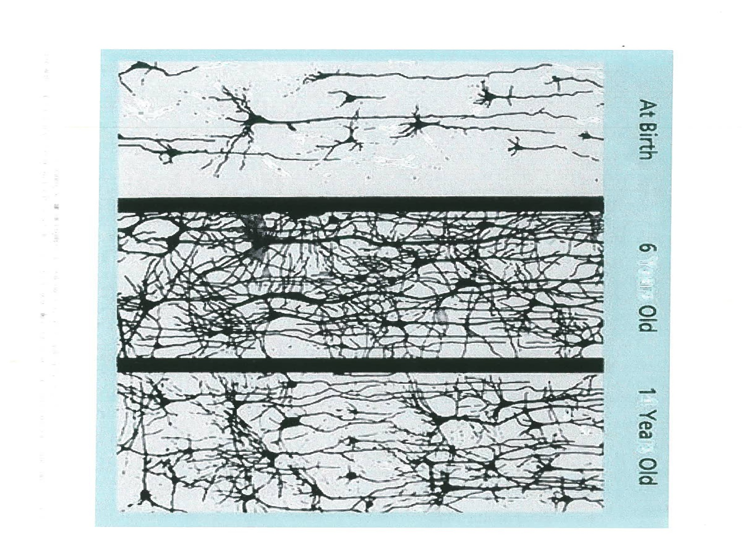
EVIDENCE FROM BRAIN IMAGING

Slide 6
THE IMPORTANCE OF STORY TIMES
Direct literacy activities for children
Enhance language development
Improve listening skills
Build observation skills
Contribute to reading readiness
Modeling behaviors to adults
Librarians demonstrate how and what to introduce to very young children

Slide 7
DIRECT INSTRUCTION TO ADULTS DURING STORY TIME
Samples of “asides” during story time:
We just clapped along with our singing of “Baa Baa Black Sheep.” Children’s songs like this one have one note for each word. This quite naturally shows your child how words are broken into syllables, a skill children need before they can learn to read.
The book we just read on big machinery probably included a lot of new words for your child. Reading informational books like this introduces lots of new words to your child. Vocabulary is important so that text has meaning once your child starts to learn to read.

Slide 8
PROGRAMS FOR BEGINNING READERS
Libraries offer a full-range of literacy-based programming for children just starting to read.
Summer reading programs
Culturally based programming such as Dia de los Ninos/Dia de los Libros, cultural heritage celebrations and more
Book discussions; You read to me, I’ll read to you programs
Therapy dog reading sessions

Slide 9
PARENT WORKSHOPS ON EARLY LITERACY
Every Child Ready to Read @ at Your Library, an American Library Association initiative
STAR (Sing, Talk and Read) at the DC Public Library

Slide 10
SIX SKILLS OF EARLY LITERACY
Phonological Awareness
Vocabulary
Narrative Skills
Print Awareness
Letter Knowledge
Print Motivation

Slide 11
EVERY CHILD READY TO READ @ YOUR LIBRARY - THE REVISED EDITION
Emphasis on the practices that promote early literacy
Sing, talk, read and play for infants and toddlers
Sing, talk read, play and write for older preschoolers
Play is both a context for the other practices and an activity in itself

Slide 12
BOOKS AND OTHER LIBRARY MATERIALS
Books and other print materials
Multi-media resources
Digital resources
The importance of trained staff to help children find appropriate materials
The role of librarians in promoting the pleasure of reading

Slide 13
THE IMPORTANCE OF PARTNERSHIPS
Libraries especially need help in locating the children and families most at risk of reading failure
Diversity of partners
Head Start – since the 1960s
Day care community
Places of worship
Teen parenting programs
Higher education
Other governmental agencies
Other community organizations which work with young children

Slide 14
Resource List
Story Blocks - Colorado State Library www.storyblocks.org/
Zero to Three www.zerotothree.org
West Bloomfield Public Library http: www.growupreading.org/
Multnomah Public Library http://www.multcolib.org/birthtosix/
Hennepin County Public Library http://www.hclib.org/BirthTo6/
American Library Association www.ala.org

